Slide 1
Detection of Humans in Images Using Skin-tone Analysis and Face Detection
Vincent Urias, Curtis Hash

Slide 2
Road Map
Introduction
Survey of current methods for
Analysis in various color spaces
Skin-tone classifiers
Illumination adaptation
Discussion of our project
Implementation
Results & analysis
Conclusion

Slide 3
Introduction

Slide 4
Project Goals
The goal of this project was
To distinguish humans from arbitrary objects
We looked at several well known methods
Clustering
Bayesian analyses
Proved to be well beyond both of our capabilities
Resolution
We then did further research and found that there were several other well known methods for skin tone analysis and we were able to accomplish this

Slide 5
Applications of Skin-tone Analysis
Face detection
Face tracking
Gesture analysis
Content-based image retrieval (CBIR)
Human computer interaction domains
Digital Forensics applications

Slide 6
Issues When Processing Images
Illumination
Camera characteristics
Ethnicity
Individual characteristics
Other factors: Different factors such as subject appearances (makeup, hairstyle and glasses), background colors, shadows and motion also influence skin-color appearance.

Slide 7
Color Spaces

Slide 8
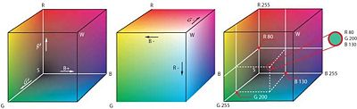
Skin Modeling in RGB Color Space
Most commonly used color space for digital images
Cameras generally use RGB to store data
Normalized RGB (r+g+b=1)
More effective than RGB
Mitigates lighting effects
Reduces the differences between skin-tone pixels due to ethnicity
Notes:
RGB – Jones and Rehg – 13,000 images – effective at detecting different skin types in various lighting conditions
Rgb – Caetano – 800 images – normalized rgb is effective

Slide 9
HSV and HSI
Hue Saturation, and Intensity (HSI)
Hue Saturation and intensity Value (HSV )
Benefits: HSV is able to cope with
High intensity white light
Ambient lights
Different surface orientations relative to the light source
Good choice for skin detection methods
Notes:
Hue—the property of a color that varies in passing from red to green
Saturation—the property of a color that varies in passing from red to pink
Brightness (also called Intensity or Lightness or Value)—the property that varies in passing from black to white.
The HSV color space has been used by
Brown et al. [14],
Garcia and Tziritas [26],
McKenna et al. [27],
Saxe and Foulds, [28],
Sobottka and Pitas [29],
Thu et al. [30],
Wang and Yuan [31],
Zhu et al. [32].

Slide 10
YCbCr and YUV
Able to reduce the redundancy present in RGB color channels
Able to represent the color independent components
Can separate luminance and chrominance components
These spaces are a favorable choice for skin detection
The YCbCr space is one of the most popular choices for skin detection
Notes:
The YCbCr space represents color as luminance (Y) computed as a weighted sum of RGB values, and chrominance (Cb and Cr) computed by subtracting the luminance component from B and R values.
Hsu et al. [35],
Chai and Bouzerdoum [36],
Chai and Ngan [37],
Wong et al. [38].

Slide 11
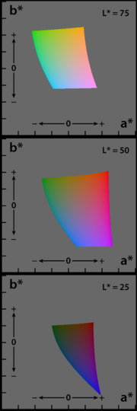
Uniform Color Spaces
CIE-Lab and CIE-Luv
Lightness component + two color components
Perceptual uniformity
Colors are arranged based on perceived difference
Approximates human vision
Transformation is computationally intensive
Perceptual difference = Euclidean distance between color points in 3D
Notes:
CIELAB – Cai and others
CIELUV – Yang and others

Slide 12
Additional Color Spaces
Combine components of different color spaces
R and G from RGB, H from HSV
Complimentary color components can be more effective than using a single color space
Use ratios of color components
R/G from RGB (single ratio)
R/G + R/B + G/B (combined ratios)
Not as widely used, but can be effective in certain domains
Notes:
Complimentary components – Gomez
Ratios – Brand and Mason

Slide 13
Skin-tone Classifiers

Slide 14
Methods for finding appropriate skin range
Color distributions of skin color of differing nationalities are clustered in small area of the color spectrum
By providing the mean and covariance values, the skin color model can be fitted into a Gaussian model
Notes:
Dai et al. used this method to find people with a yellow skin pigment
Sobottka et al. and Wang et al. used experientially determined values on HS color space.
Garcia et al. segmented skin by using eight planes in YCbCr space or by using six planes in HSV space.
Yao et al. used YUV space to detect skin chrominance and lip chrominance .

Slide 15
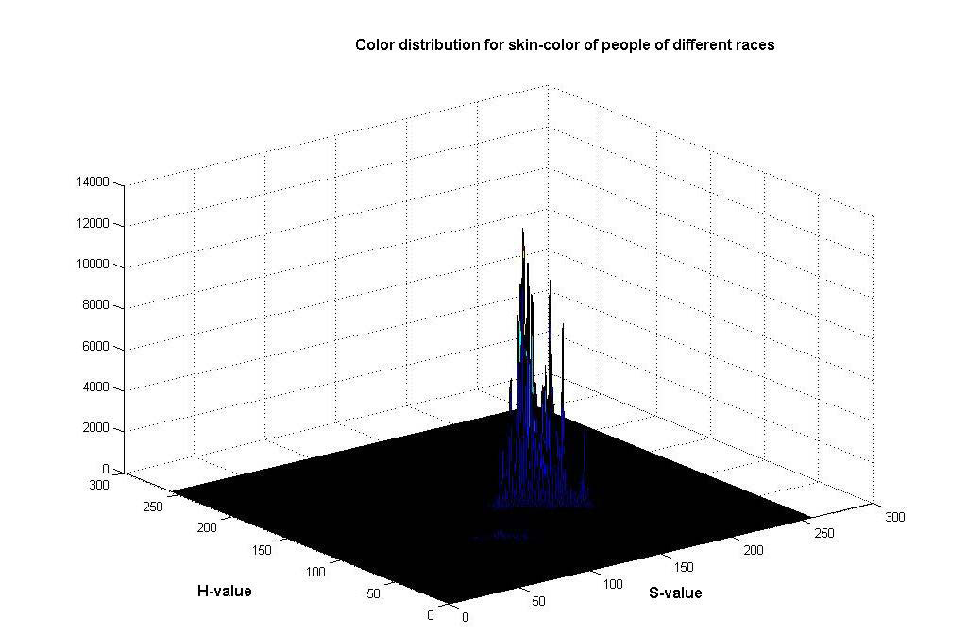
Distribution of skin-color

Slide 16
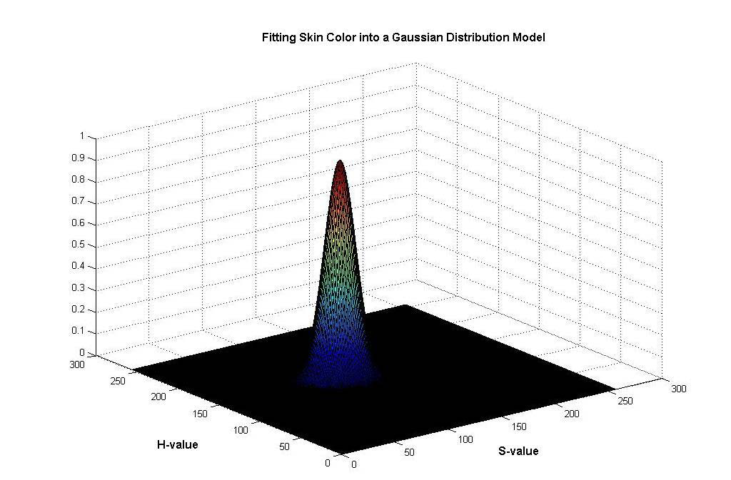
Gaussian distribution model

Slide 17
Self Organizing Maps
The self-organizing map (SOM) algorithm is based on unsupervised, competitive learning
The SOM can serve as a clustering tool of high-dimensional data and low-dimensional data
Can train to learn skin-color and non-skin-color pixel distributions
SOM can generalize well
Notes:
Brown et al trained two separate SOMs to learn skin-color and non-skin-color pixel distributions on a dataset of over 500 images. The results showed that the choice of color space is more critical to the effective performance.
Jones et al evaluated the performance of the SOMs on smaller datasets and it performed significantly lower.
Thus the conclusion drawn is that using a larger training data and larger number of neurons is needed for optimal performance of the SOM.

Slide 18
Bayesian
Bayesian networks (BN) are probabilistic graphical models that represent a set of variables and their probabilistic independencies
Sebe et al. used a BN for skin modeling and classification
Training data of 60,000 samples
Detection rates of 95.82%
Only 5% false positives
Notes:
Sebe One of the problems with pattern recognition approaches is the availability of labeled training data. The authors propose a new method for learning the structure of the BN with labeled and unlabeled data. They used a stochastic structure search (SSS) algorithm for learning the structure of the BN, which improves the performance over NB and TAN classifiers.

Slide 19
Histogram Classification
Represent range of skin tones as a color histogram
Quantize the histogram into color “bins”
Use training data to calculate the probability that skin falls within each bin
If probability is above a certain threshold, the pixel is classified as skin
This method has been used extensively by many researchers

Slide 20
Histograms and Bayes ML
Two histograms built from training data
Skin & non-skin classes
Create tables P(skin) and P(not skin) for each color
The overlap between the two can be mitigated by Bayes maximum likelihood
P(skin) / P(not skin) > threshold
Simple and fast once the tables are built
Notes:
Research has been done effectively by Jones and Rehg
2 billion pixel training set
77% of possible colors not encountered
10% of total pixels were skin
Fast and accurate with unconstrained images
Overlap between the two histogram classes is reasonable

Slide 21
Summary of Skin Classifiers
Goals
Identify different skin types (light to dark tones)
Mitigate effects of lighting conditions
Reduce false positives due to backgrounds
Most classifiers are too specific
Detect only a subset of skin types
Work only under certain lighting types

Slide 22
Summary continued…
Most popular color spaces
RGB and normalized RGB
The majority
require an extensive training data set to be effective
Work only on a specific skin type
Comparisons between classifiers on the same data set is lacking

Slide 23
Summary continued…
Maximum skin detection cannot be done without many false positives
Results are highly dependent on the chosen thresholds
There are no “magic thresholds” that work under all conditions
Trade offs
Speed, efficiency, storage, training period

Slide 24
Illumination Adaptation

Slide 25
Illumination Adaptation
Humans can adapt to different lighting
Color constancy
Effective skin tone analysis must compensate for
Shadows
Illumination angle
Excessively dim or bright lighting
Most techniques work within a limited range of conditions

Slide 26
Gray World/White Patch Approach
Assume the brightest part of an image is white
The average illumination should be gray
Find the top 5% of luminance values
This becomes the “reference white” of the image
Scale the R, G, and B components linearly such that the average is gray, and the brightest part of the image becomes white
Widely used method
Notes:
Kovac
40 images
“color correction improves the performance”

Slide 27
Skin Locus Approach
Use a training dataset to calculate the expected color of skin under different lighting conditions
Create a “locus” for representative lighting conditions
Horizon, Incandescent, Fluorescent, Daylight
The determination between skin vs. non-skin pixels can be made by thresholding distance from the locus
Notes:
Storing

Slide 28
Implementation

Slide 29
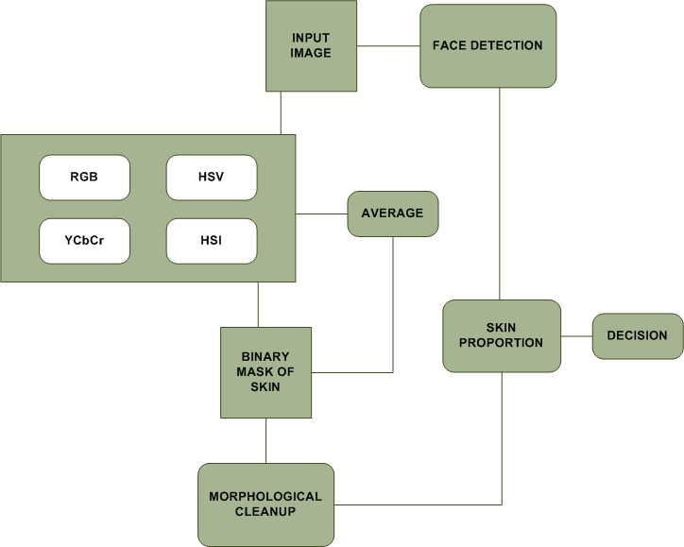
Implementation

Slide 30
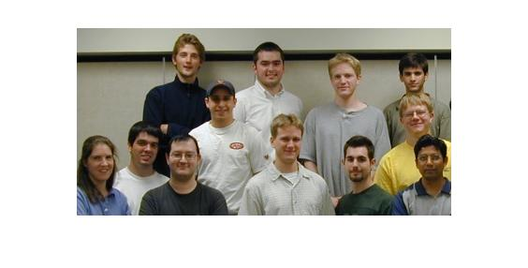
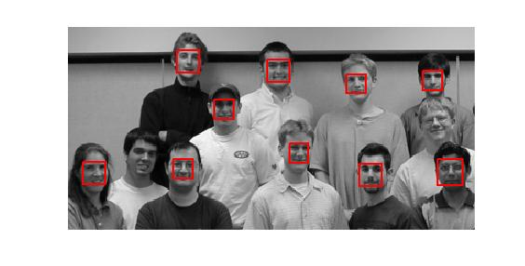

Slide 31
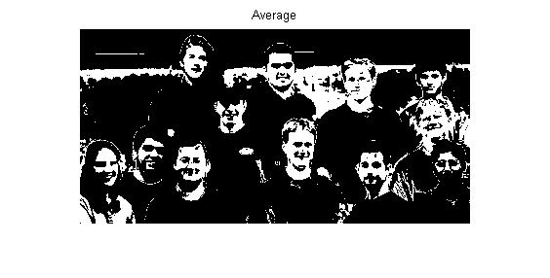
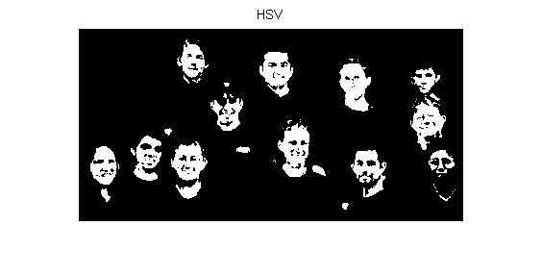

Slide 32
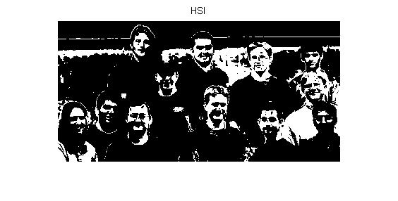
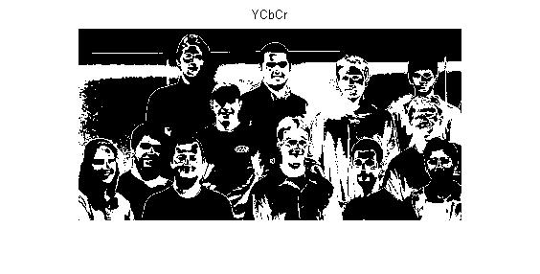


Slide 33
Analysis

Slide 34
Hypothesis
Current methodologies perform reasonably well under certain conditions; however, they produce too many false positives
By coupling and filtering differing techniques, false positives can be reduced

Slide 35
Dataset
Unconstrained dataset
A collection of 1880 images
Representation of college life
Diverse collection of people, buildings, outdoor scenes
Multitude 0f lighting conditions
People are in differing positions, differing nationalities and skin tones

Slide 36
Skin-tone Threshold
Skin tone ranges were initially taken from journal articles
These values were not adequate to support the unstructured dataset
Ultimately, the values were found using experimentation

Slide 37
Test Cases
Analysis in each color space
HSI, HSV, RGB, YCbCr
Average was taken as an additional metric
We ran the tests in the following configurations in order to evaluate the overall performance of each aspect
Skin detection only
Face detection only
Skin AND face detection
Skin OR face detection

Slide 38
Notes:
Combined and the worst and the best characteristics to get an average performance
Was not particularly effective

Slide 39
Notes:
Fewer false negatives
More positives, better at detecting skin
But many false positives because it overdetects skin in non-skin images

Slide 40
Notes:
Best at detecting “face skin”
Better at detecting shadows and varying lighting across the face
Face finder worked best with HSV

Slide 41
Notes:
Detected the least amount of skin
This made it good for eliminating false positives (because it had few positives)
Very sensitive threshold

Slide 42
Notes:
Most false negatives (because it’s bad at detecting skin)

Slide 43
Conclusion
All of the color spaces performed similarly
Face detection alone is overly sensitive to changes in facial orientation, many false negatives
Combining face detection with skin detection
Greatly reduced false positives, but …
Greater number of false negatives (due to facial orientation)
Color thresholding alone is too general, many objects contain skin-like tones (false positives)
A combination of methods and color spaces is best

Slide 44
Future Work
Training datasets to determine more robust thresholds for each color space
Incorporation of classifiers and adaptive illumination methods
Incorporation of a better face detection algorithm
Other feature detection algorithms

Slide 45
Questions?
Thank you

